Slide 1
GWUSales
Akbar Sattar, Nursultan Makhanov, Yuzhen Li
Notes:
Akbar

Slide 2
Introduction
Yuzhen Li: Meeting Organizer
Nursultan Makhanov: Expert Programmer
Akbar Sattar: Concept / Idea manager
Special Thanks: Baubek Ukibassov
Notes:
Akbar

Slide 3

The Problem
New to DC?
Need furniture?
Nowhere nearby to get furniture?
We hear you and we will fix this!
New goods are expensive, used ones are cheaper
Many people have junk lying around that perpetually sits in a corner
Transportation is expensive
Why not buy something that someone does not need anymore?

Slide 4

What is GWUSales?
A quick and efficient way to buy and sell things, including:
Furniture
Transportation
Clothes
Food
Apartment renting
Localized by campus
Limited to GWU for now
Fast and easy to use
Android
For now
Notes:
Akbar

Slide 5
Demonstration
Notes:
Yuzhen and Sultan and Akbar

Slide 6
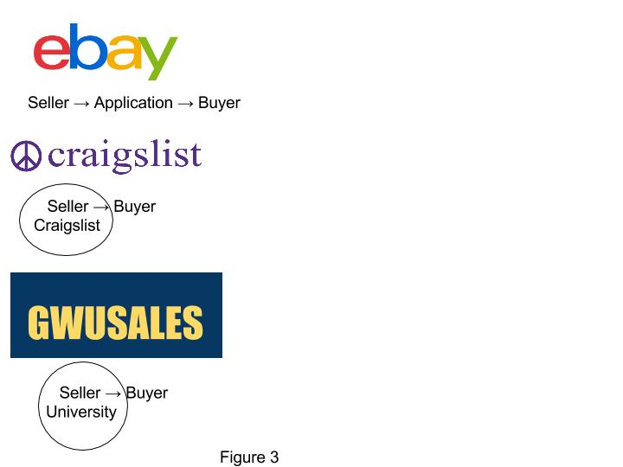
Advantages over competitors
Safety
Craiglist has a dark reputation
Others are anonymous, you don’t meet actual people
Community
Can meet new people
Distance
Why drive 30 minutes, or order things you haven’t seen before
You can buy something that might even be your neighbors!
Easy to use
Scroll through listings just like in Instagram
Location based
Will show nearest items first
More anonymous than FB Page, still safe
Notes:
Akbar

Slide 7


Technology
Server side:
Parse
Client Side
Android SDK
Were originally using MySQL , switched to Parse
Regex
Email Verification Software
From Parse.com
Notes:
Sultan

Slide 8



Future Ideas
Facebook integration
Support for multiple/all Campuses
Paid “GWSales Express”
Cheap monthly fare, allows for unlimited sales
iOS & Browser based version
Terms & Conditions
Product customization
Search function
Notes:
Yuzhen

Slide 9
Questions?
Thank you very much! We hope you enjoyed our presentation! Look out for our app!

